Slide 2
Drupal 8 Migrate: Taming the wild west Learning new tricks
Notes:
Title Page

Slide 3
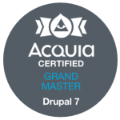

Who am i?
Software developer since 1990 or so.
Drupal developer since 2013.
I work for Breakthrough Technologies.
Love the Drupal community (that’s you!).
Back-end developer. I’ll theme something if I *have* to. (I mean, look at how pretty this slide is!)
Contributor to a handful of modules.
Oh, and BTW, Acquia Certified Grand Master!
And my favorite Muppet is Pepé the King Prawn.

Slide 4
What we’ll cover
A very brief overview of how Migrate works
Must-have contrib modules
Some different source plugins
A bunch of process plugins
Writing your own plugins
One or two things about destination plugins
Live demos!

Slide 5
What we won’t cover
Upgrading legacy sites with Migrate. There are lots of good talks on migrating D6 or D7 sites to D8.
The many differences between D8 Migrate and D7 Migrate. (Well, I’ll rant some, but this isn’t really a topic for today.)
Multi-language imports – we can do it but it’s outside of the scope of this talk.

Slide 6
How does this Migrate thing work, anyway?

Slide 7
Migrate flow
Source
Process
Destination
Notes:
Full page image treatment

Slide 8
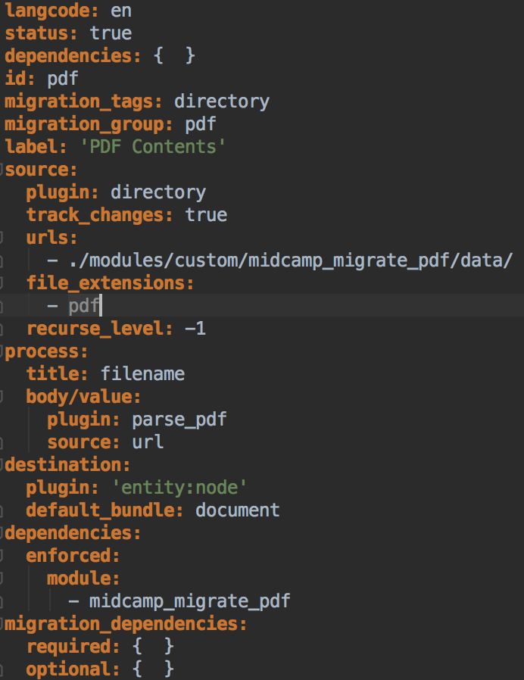
A brief overview
Start with a Source plugin. This is where your data comes from. For instance, a CSV file.
The results of that Source are converted and mapped to your Destination with Process plugins. Map source data to destination fields or manipulate source data. Everything you build in your process section becomes a destination field.
A Destination determines where your data will end up. Most of the time, that’s a Drupal entity.
Notes:
migrate_plus.migration.pdf

Slide 9
This all sounds great. How can I start using Migrate?

Slide 10
What you’ll need
Migrate is in Core now, so you already have it. But to be really productive with it, you need some more stuff.
Absolute must-haves:
migrate_plus
migrate_tools
Something that makes stuff way easier:
migrate_devel
config_update

Slide 11
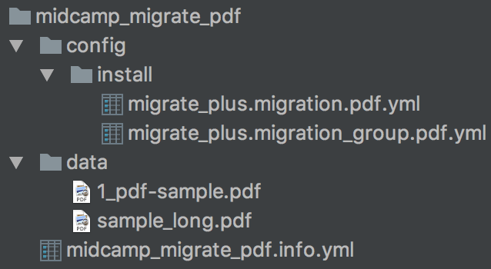
How to do it
Create a new module. (Just a directory and a .info.yml file). (Or drupal gm)
Create directory config/install.
Add a config file for a group in config/install.
Add a config file for a migration in config/install.
Enable the module.
Run drush ms to see it in the list.
Drush drush mim to run it.
Notes:
----- Meeting Notes (2/22/18 20:14) -----
Go to the info file in the module already up - midcamp_migrate_pdf.info.yml

Slide 12
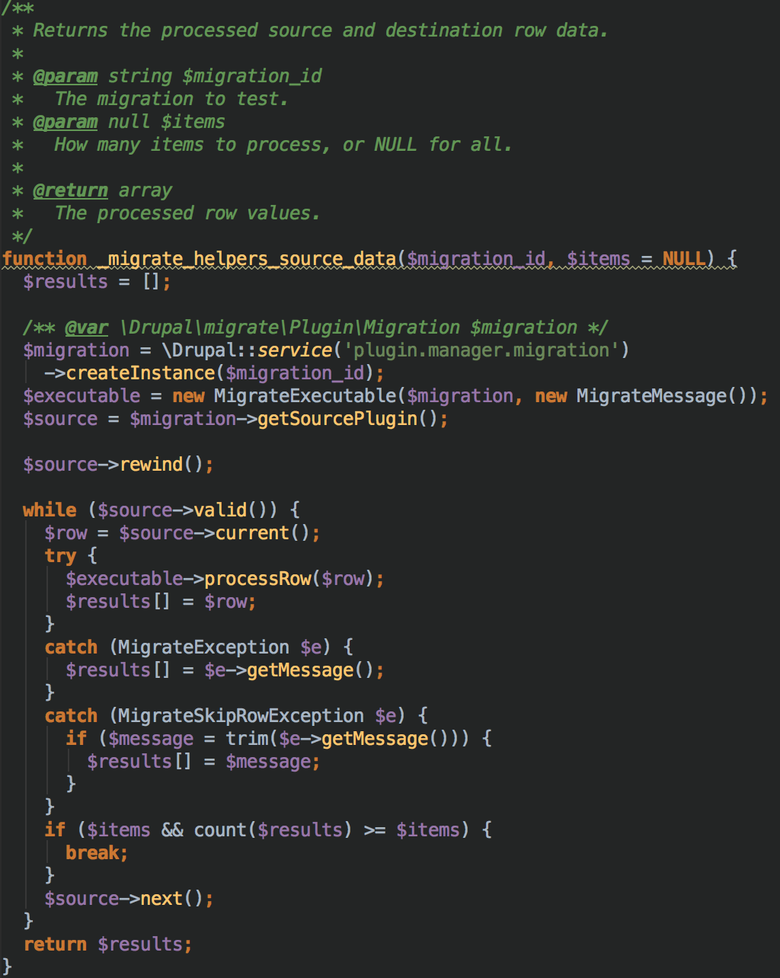
How to test it
Helper module.
Run MigrateExecutable->processRow() without saving the row.
Don’t try to copy that! The code is at http://tiny.cc/midcamp_migrate_code

Slide 13
A custom source plugin

Slide 14
Source plugins
Source plugins get data. I rarely have to write a custom source.
There are source plugins out there already for:
JSON
CSV
Files in a directory structure
Different versions of Drupal
MySQL

Slide 15
Dissecting a Source plugin
Look at migrate_source_directory and its Directory plugin. It’s a great pattern to follow.
You need:
initializeIterator() – returns an iterator of your data
fields() – returns an array of the fields available for this source
getIDs() – returns which fields uniquely identify a row
Look at SourcePluginBase. Its doc isn’t quite correct, though.

Slide 16
Demo time!
Let’s look at the results of a source row. We’ll use a migrate_source_csv and a list of cars.
$results = _migrate_helpers_process_row('cars', 1, FALSE);
ksm($results);

Slide 17
A custom process plugin

Slide 18
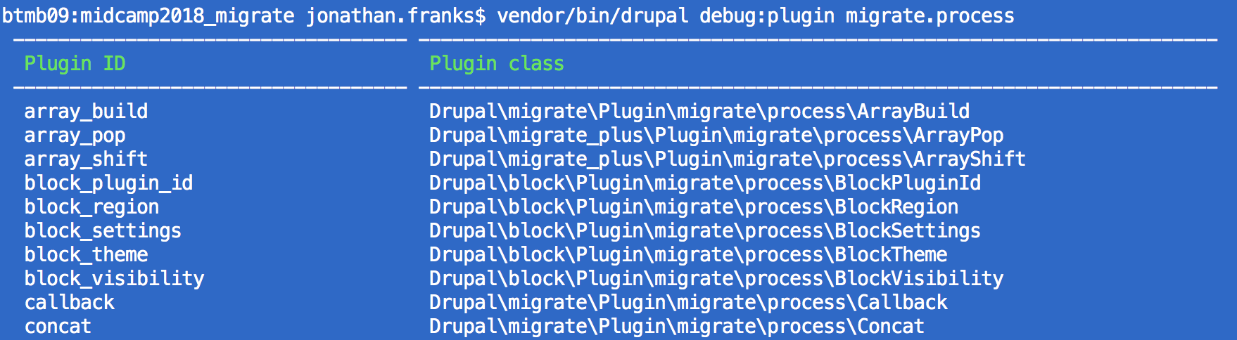
Process plugins
Process plugins do things to data. Your custom work will likely be here.
See what’s already on your site with Drupal console:
drupal debug:plugin migrate.process

Slide 19
Dissecting a process plugin
Process plugins can be super simple. All you need is a transform() method.
Check out ArrayPop in migrate_plus. It’s just a transform() method that checks to make sure $value is an array, then does an array_pop() on it and returns it.
Easy peasy!

Slide 20
Writing our own process plugin
Example time!
Here is a process plugin to parse the contents of a PDF file using smalot/pdfparser.
First, the annotation.

Slide 21
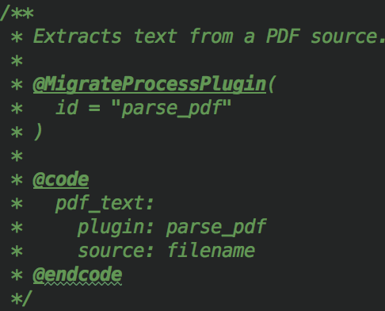
Process plugin annotation
Identify it as a process plugin (@MigrateProcessPlugin) and give its ID.
Then a sample of how to use it. All it needs is a file name, which is what the transform() method will take as its $value argument.

Slide 22
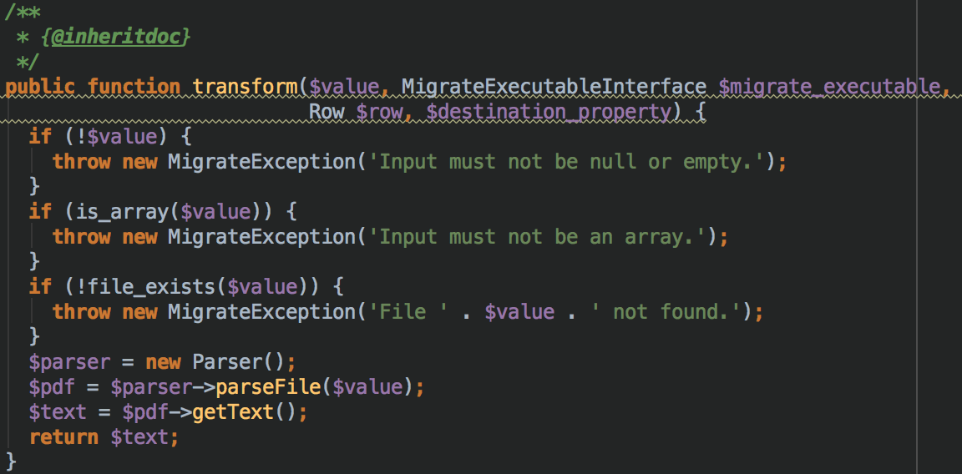
Process plugin Transform method
Our transform() method does some simple validation.
Then it gets the text from the PDF with the parser and returns it.
That’s it!

Slide 23
Demo time!
Let’s have a look at a process plugin that provides the text inside a PDF file:
ParsePDF
Let’s see what it does with our helper.
Our migration is migrate_plus.migration.pdf.yml so we can run:
$results = _migrate_helpers_process_row('pdf', 1);
ksm($results);

Slide 24
A custom destination plugin

Slide 25
Destination plugins
A destination plugin determines where your data will end up. Most of the time, you won’t need to be writing these at all, because most of what we do with Migrate involves pulling data into Drupal from other sources.
Let’s dive into an example that exports migrated data into a CSV.

Slide 26
Example time
Let’s look at modules/custom/migrate_destination_csv/src/Plugin/migrate/destination/Csv.php
And run it with drush mim cars_to_csv
And see our output in export.csv

Slide 27
Practice with NASA

Slide 28
Live demo!
Let’s look at modules/custom/midcamp_migrate_mars_rover
We have three migrations in here, one for the Rover data, one for the Rovers’ cameras, and one for the photos and photo metadata.
We’ll create terms for the Rovers and the cameras, then import the photos as file entities and create nodes so we can see them.
And run it with drush mim –group=nasa
BUT!!!

Slide 29
Live demo!
We have something much cooler in store.
Let’s run the Rover and camera imports from the command line.
drush mim rover
drush mim rover_cameras
Then let’s head over to /rover/migrate.

Slide 30
Live demo!
Now let’s move all of this data to another Drupal 8 site.
I happen to have one right here…

Slide 31
Q&A?

Slide 32
Resources
Code used in this demo:
http://tiny.cc/midcamp_migrate_code

